Slide 1
Accident Detection And Car Crash System
Prepared by Group 16:
Parthkumar H. kakakdiya (420606)
Devang K. Soni (431044)
Mayur B. Raiyani (420200)
Faculty of Engineering
Department of Electrical Engineering & Computer Science
Subject: Special Aspects of Automation Task: IoT Project
Guided by:
Dipl.-Ing. Uwe Starke,
Prof. Dr.-Ing. habil. Olaf Simanski

Slide 2
List of Contents
Aim of This Project
Block Diagram
Flow chart
Prototype Model of the Project
Future Aspects

Slide 3
Aim of This Project
The main goal of this project is to design and construct a project to control accidents caused due to alcohol consumption. This system improves the safety of human beings. And if an accident happens for any reason , then it automatically informs the responsible person.

Slide 4
Block Diagram
Raspberry pi
Alcohol sensor
Tilt sensor
Arduino UNO
Output from Cloud

Slide 5
Flowchart
Start
driver check alcohol content
check car tilt level
No
If Alcohol Content > Pre-fetched Threshold
Yes
Send alert to pre-fetched numbers and address
No
Tilt level has increased
Switch off Engine
Yes
Send Address to Taxi Company
End
Store data in cloud
End

Slide 6
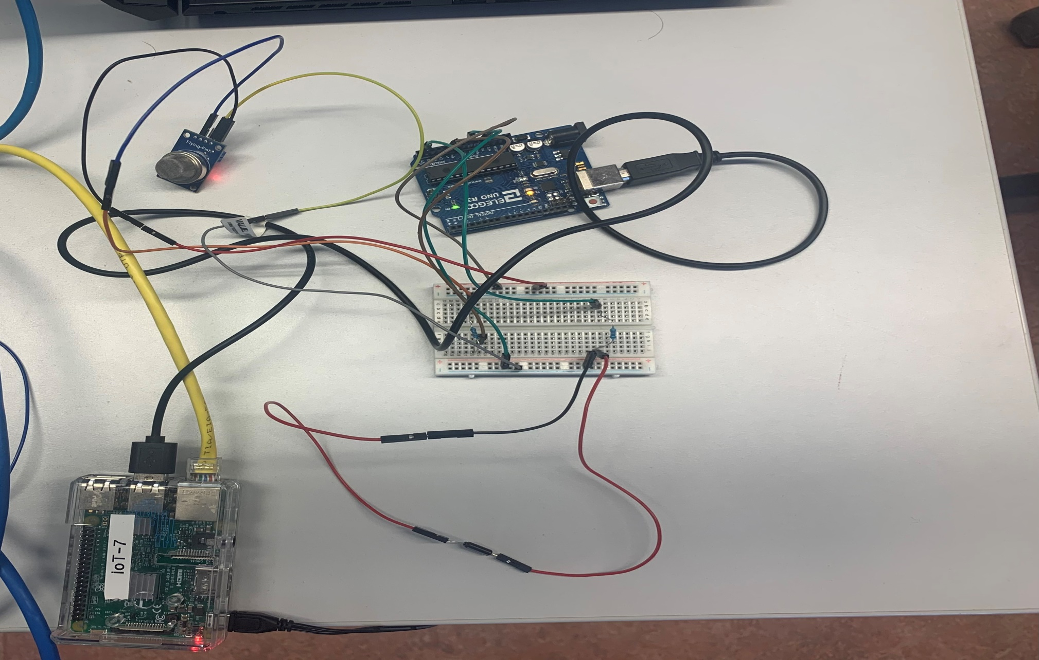
Prototype Model of The Project

Slide 7

Future Aspects:
We can identify the dangerous road.
We can implement GSM technology with an alcohol detector. So Alcohol detection & vehicle controlling through text SMS.
We can implement GPS technology so that once alcohol detection is done, the system will find out the location of the vehicle.
Recognizes traffic accidents automatically and allows immediate rescue after transmission to emergency recovery agencies.

Slide 8
Reference
https://www.wikipedia.org/

Slide 9
Thank You

